Slide 1
Instructions on making a poster
Slide 2 is a poster template – all the fonts, the size of the poster etc are pre-set.
  Do not change the size of the poster (42 x 31)
  You may have colored images and text
  You may NOT have a colored background
The template is a guideline. You can type right over the text I have placed there. Adapt it as necessary to accommodate your work.
What often works well is taking your summer presentation and using the figures from those slides to make your poster. Your mentor may have additional recommendations.
Use your own images, figures, spectra, graphs etc rather than clip art
  You may add Muhlenberg College graphics in the title area
  Don’t forget about your summer photoshoot! Those photos are great on your poster as well ☺

Slide 2




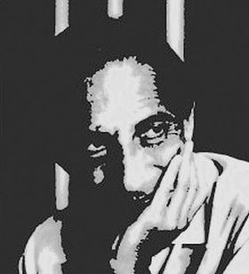


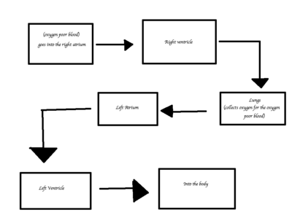

The Title of My Humanities Project
Joe Student, John Collaborator, and Dr. Jill Mentor
Department of Humanities, Muhlenberg College
Funded By: Generous Funding Agency
Fun picture of my research
(muhlenberg icon)
Introduction
What were you initially interested in? What questions got you started in this area of inquiry?
What Interpretive frameworks, theories and/or historical narrative provide context your investigation?
Answer the “so what?” question. Why is this work important?
The Project
The important section! What did you do, how did you come to your conclusions, and how have you backed them up? What are the key ideas or pieces of information that led you to your conclusion and developed your thinking? For example, if you are investigating a text or piece of art, you might group your observations to help the reader make sense of your project.
Conclusions
What are your preliminary conclusions? Your big ideas?
How is your work contributing to and distinct from the existing scholarly communities within this discipline?
Revisit the “so what?” question. How is this work important?
“A quote from your subject text could be useful if you are analyzing text or conducting interviews”
Use images that provide a visual representation of the theoretical or historical narrative in which your research in located.
Use images and/or quotes to help your reader understand the process you followed.
Summarizing important conclusions is helpful
What were your most important discoveries?
If you examined several works or subjects then you could visually organize your thinking according to the piece or subject examined.
Materials and Methods
Primary and secondary documents
Special Collections accessed
Modes of analysis employed
Do you have images of any of these items?
Can you visually organize your conclusions using a chart or diagram?
If you used several modes of analysis or theoretical frameworks, group observations according to the mode employed
What are your future directions? Where will you go/do next?
Literature Cited (use the reference style most applicable to your discipline)
Smith, Ann. (2000) A Very Important Book, “A very important chapter in this book” p. 10
Brown, J. Another resource I used (1996)
If you have a lot of references, then you can use a smaller font here.
Acknowledgments
Here is where you list the people who helped you. Research advisor, librarians, other students or faculty.
Notes:
If you had a summer photo shoot of your research, then this is a great source of photos for your poster. If your subject does not easily lend itself to images, then use the images of YOU studying your subject.

Slide 3
Instructions on printing your poster
Save this file under a new file name with the format: Yourlastname_postersession_2018
Delete all instructions slides and save
  The file will now contain one slide, and it will be the slide of your poster
Now save the file again as a PDF. Under Save as > pdf
Submit the pptx and pdf files to the assignment link in Canvas by September 14, 2018
Your poster will be delivered to the CA on 9/22. Arrive between 10:30-10:45am to hang your poster.

Slide 4
Instructions on presenting your poster
Retrieve your poster and pin it up on an easel in the CA by 10:45am on Saturday morning, 9/22
Dress professionally
Greet visitors as they come to your poster, you could say – “Hi, I’m Joe, would you like to hear about my research?”
Give an interested visitor a guided “tour” of your poster – i.e. walk them through from intro to conclusions, pointing out the highlights.
Thank each person for visiting your poster

Slide 5











Muhlenberg images you may want to use in your poster

